Slide 1
KISSY MVC Overview
yiminghe@gmail.com
2011-11-17 Draft

Slide 2
mvc 模块
KISSY.use (“mvc”,function(S,mvc){
mvc.View => 视图
mvc.Model => 模型
mvc.Collection => 集合
mvc.Router => 路由
mvc.sync => 默认系统同步
})

Slide 3
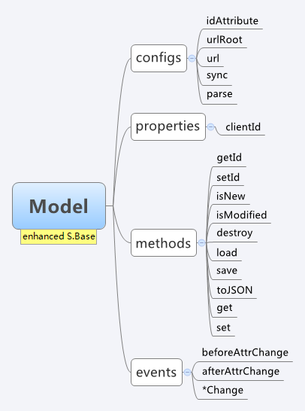
Smart Model
Flexible data transfer
sync
parse
url
urlRoot

Slide 4
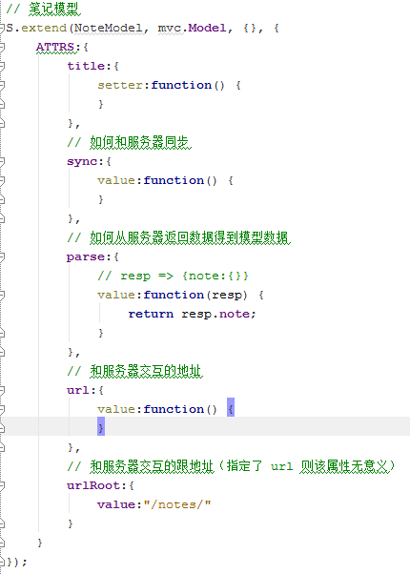
Smart Model
默认服务地址：
/notes/{noteId}

Slide 5
Smart Model
Event-Driven
*Change
BeforeXChange
AfterXChange

Slide 6
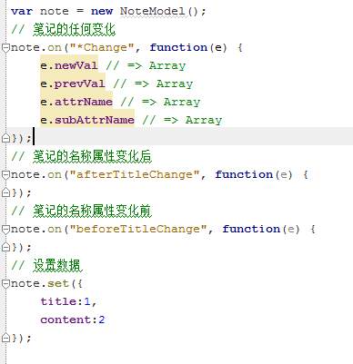
Smart Model Code

Slide 7
Smart Model
Server-Transparent
Load
Save
destroy

Slide 8
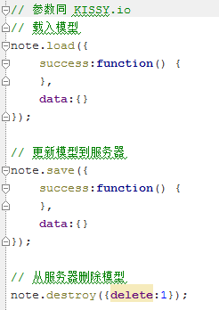
Smart Model

Slide 9
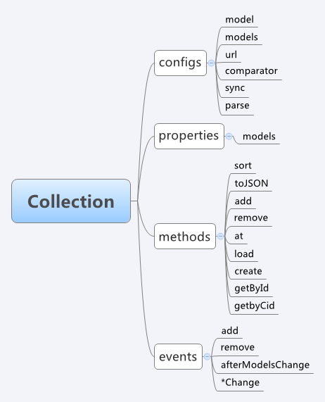
Smart Collection
Flexible data transfer
sync
parse

Slide 10
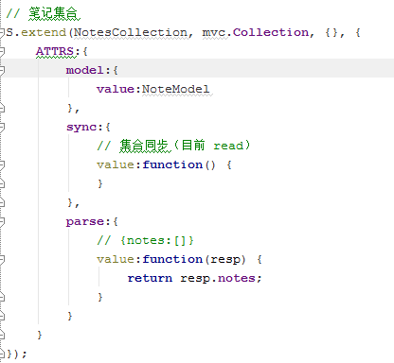
Smart Collection

Slide 11
Smart Collection
models management
sort
getById
getByCid
Add
Remve
S.each
S.filter

Slide 12
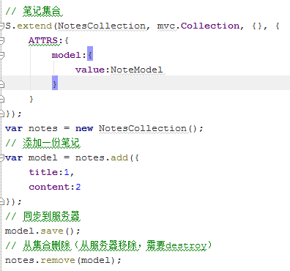
Smart Collection

Slide 13
Smart Collection
Event-Driven
Bubbled *Change
add
remove
afterModelsChange
( .load() )

Slide 14
Smart Collection
Server-tranparent
load
create

Slide 15
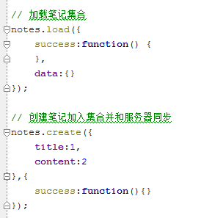
Smart Collection

Slide 16
Dumb View

Slide 17

Dumb View
Controllable View With DOM Event

Slide 18
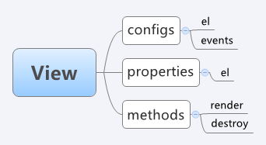
Controllable View
Delegate Events
Create Container
bookmark?
router
model
view
!bookmark?
model
view
Notes:
保证 model 和 view 的同步， view 不直接操作 view

Slide 19
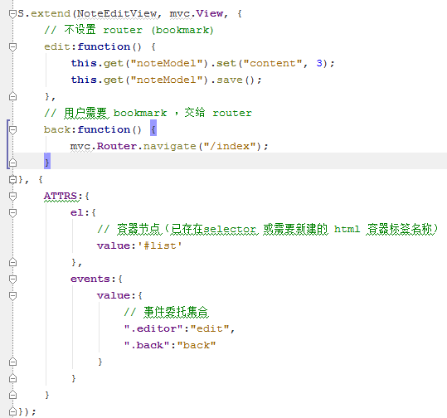
Controllable View

Slide 20
Powerful router
url hash dispatched to function with path param and query param (intelligent dispatch)
“/edit/:id” -> fn
/edit/99?q=1 => fn(pathParam,queryParam)
pathParam => {id:99}
queryParam => {q:1}
“/new/*path”
/new/kissy-mvc/is-good => fn(pathParam)
pathParam => {path:”kissy-mvc/is-good”}
“/*path”
Notes:
Route 规则最优匹配用户输入的 url

Slide 21
Graceful html5 support
Promotion @ Html5 History
http://xx.com/#new
=>
http://xx.com/new
Degradation @ html < 5
http://xx.com/new
=>
http://xx.com/#new

Slide 22
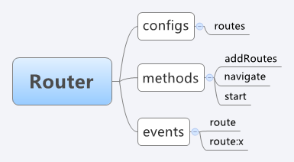
Router Events
Also some events
hashchange
route
model
view

Slide 23
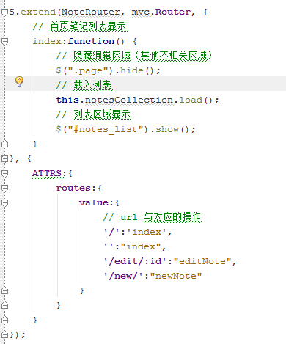
Powerful Router
Notes:
主要作用为记录状态

Slide 24
Global sync
mvc.sync
Load notes list => /notes/?_method=read
Update note => /notes/noteId?_method=update
Delete note => /notes/noteId?_method=delete
Create note => /notes/?_method=create
Load single note => /notes/noteId?_method=read

Slide 25
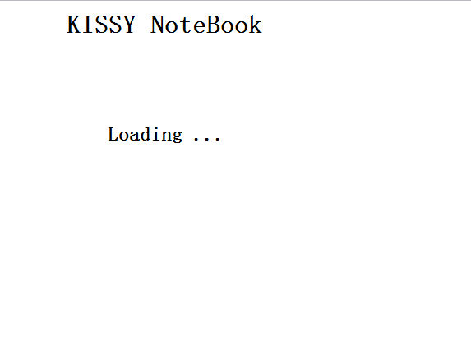
Example
KISSY Notebook

Slide 26
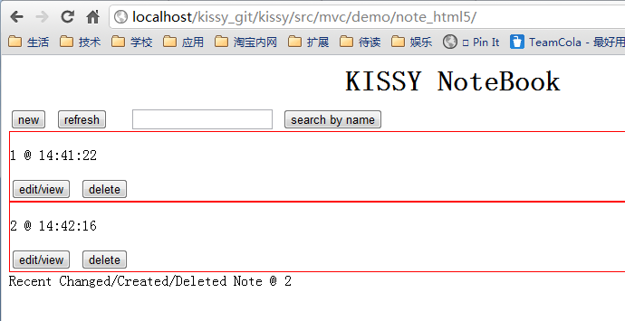
list

Slide 27
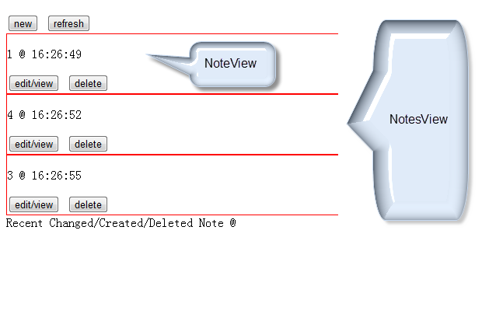
NotesView/NoteView

Slide 28
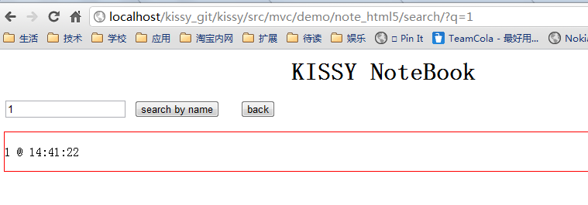
SearchView

Slide 29
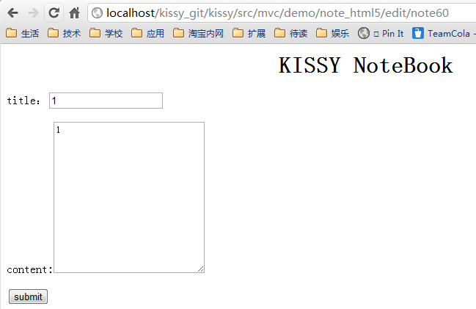
EditView

Slide 30

Router

Slide 31

Sync
Using localStorage

Slide 32
Refer
API:
http://docs.kissyui.com/docs/html/api/component/mvc/index.html
Demo:
http://docs.kissyui.com/kissy/src/mvc/demo.html

